Slide 1
A Brief History of Canadian Identity

Slide 2

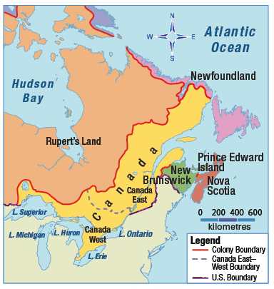
A Vision of a Responsible Government
Early 19th century, British North America —now Canada—was still controlled by Britain.
In 1841, the British government merged Upper Canada (anglophone) – renamed Canada West and Lower Canada (francophone)- renamed Canada East.

Slide 3
The new province had one legislative assembly with equal representation from Canada East and Canada West, even though less people lived in Canada West.
English was the only language allowed in the legislature because the British wanted francophones to assimilate into anglophone culture.

Slide 4
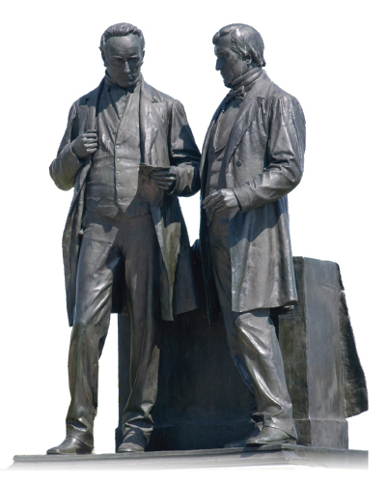
Louis-Hippolyte LaFontaine (Canada East) and Robert Baldwin (Canada West) joined forces to demand responsible government.
They wanted a government that would answer only to the people of Canada, not to the colony’s British governor.
Both wanted the language an culture of Canada’s francophones to survive.

Slide 5
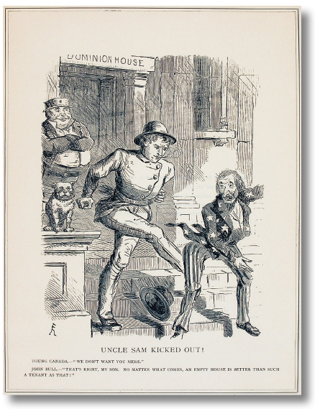
Confederation: A New Vision of Canada
In 1866, the U.S. passed an act proposing that the U.S. take over all of Britain’s colonies in North America.
The economy was suffering because Britain and the U.S. had restricted trade with the British colonies
A flood of English-speaking immigrants to Canada West meant that anglophones were beginning to outnumber francophones in the province of Canada.

Slide 6
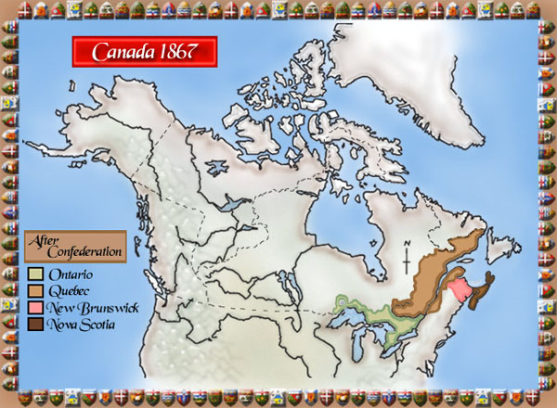
In the 1860s, led by John A. MacDonald and George Etienne Cartier, the goal of an independent Canada was pursued. One that preserved its British heritage and promoted the language and culture of its francophone citizens.
The new country of Canada was created in 1867.
It was made up of four provinces: Ontario, Quebec, Nova Scotia and New Brunswick

Slide 7
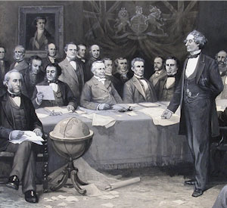
The British North America Act, which created Canada, defined two levels of government
The federal government was to look after national affairs.
The four provincial governments would manage their own affairs.

Slide 8
Evolving Visions of Canada
B.C joined Confederation in 1871 on the promise that a railway would be built connecting Canada’s east and west coasts.
Once the railway was finished, Canada could begin to secure and populate the West.
The railway would transport people and supplies. But the newcomers would need land.

Slide 9
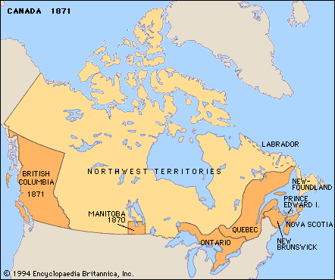
Prime Minister Wilfred Laurier believed that the U.S. would try to take over the West if few people lived there.
He gave the job of populating the West to Clifford Sifton, the minister of the interior.
At first, Sifton wanted only British and American immigrants, but few were willing to come.

Slide 10

Sifton set up immigration offices in non-English speaking European countries.
Soon communities of Poles, Germans, Ukrainians, Finns, Norwegians and others began to appear on the Prairies.
English people were no longer as dominant and francophones were deeply affected as most of the immigrants chose to learn English instead of French.

Slide 11
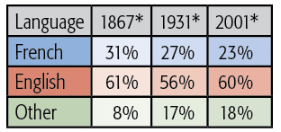
Challenges and Opportunities for Francophones
The percentage of francophones in Canada was shrinking and as a result the power and influence of francophones in Canada began to decline leaving them with 3 options:
Accept it
Promote Quebec as a strong, self-governing province within Canada
Promote a vision of a sovereign (separate) Quebec.

Slide 12
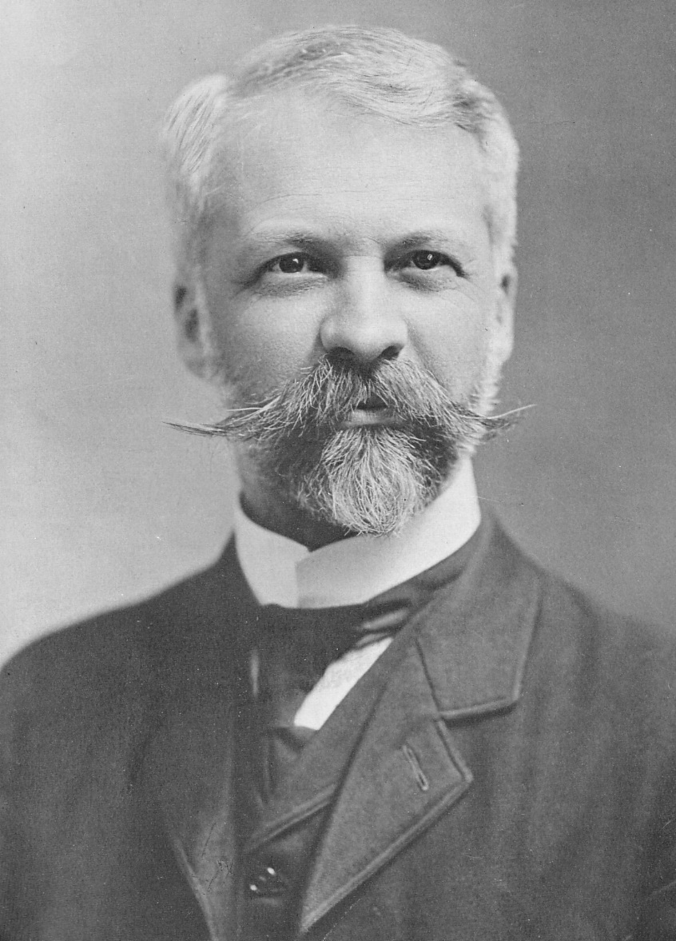
Henri Bourassa was a Quebecois leader who believed that Francophone culture must keep its equal status in Canada.
As Canada’s identity continued to change, he became more and more anti-British.
He led the opposition to conscription during World War I

Slide 13
Maurice Duplessis fought for a more independent Quebec by focusing on the traditional values of church and community.
This was the beginning of what is referred to as the Quiet Revolution: modernizing Quebec by improving social programs and the education system to affirm and promote Francophone culture in Quebec.
To reach these goals, many believed that Quebec must control immigration, industry, language laws, and some aspects of foreign policy
For some, sovereignty was the only way to do this.
Rene Levesque and others founded the Parti Quebecois to promote independence for Quebec

Slide 14
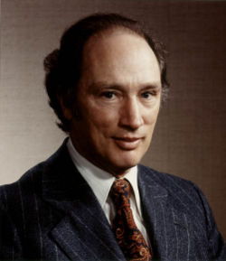
In 1968, Pierre Trudeau was elected prime minister.
Although he was Quebecois, his vision was of a strong, united Canada.
His government passed the Official Languages Act in 1969 to protect the language rights of all Francophones in Canada.

Slide 15
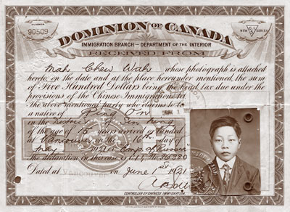
Immigration Issues for Canada
Chinese – welcomed to come and build the railroad but afterward were subject to a head tax (by 1904 it was $500). In 1923, the government banned almost all immigration from China.

Slide 16
Not Wanted in Canada
Black immigrants from the United States
Doukhobors
Jews
Ukrainians
People from other Asian countries

Slide 17
Asserting Aboriginal Rights
John A. MacDonald’s vision of an expanded Canada became possible when the government purchased Rupert’s Land from the Hudson’s Bay Company
This vision completely ignored the Metis people living in the Red River area of what is now Manitoba.
In 1876, Parliament passed the Indian Act which gave the federal government complete control over the lives of First Nations people

Slide 18
Over the years the Indian Act was changed many times, but First Nations people were rarely consulted about those changes.
Today, many First Nations are in the process of settling land claims and asserting their rights to traditional lands and to govern themselves.

